Slide 1
Capstone design project 1 Midterm Presentation
Team Strangers
2011105018 Kim Sang Min
2012097080 Jeon Ji Hoon
2012105075 Lee Chang Hyun

Slide 2
Index
1. Project Introduction
2. Progress
> The original design
> Research
> Present
3. Future Plan
4. Demonstration
5. QNA

Slide 3
Project Introduction
Project name : KNU map
Development Tool : Eclipse, Android Studio, Github
Language : Java
Target machines : Upper Android 4.4(Kitkat)

Slide 4
Progress
The original design
Use Dijkstra algorithm to find path
To find an efficient path, use coordinate
Divide the map into sections to reduce time complexity

Slide 5
Progress
Research
Kyungpook National University is small enough
-> Coordinate is unnecessary
-> Dividing map by section is also unnecessary
Dijkstra Algorithm can find path fast enough

Slide 6
Progress
Present
Dijkstra Algorithm implementation using Java Language
Check it running test cases with 300 nodes and 20000 edges
-> it takes about 2 seconds
Test with 1000 nodes and 100000 edges
-> it takes about 6 seconds
Average edges per node is about 8
Fast enough

Slide 7
Future Plan
Data Gathering
1. Do the leg work (Details)
2. Refer to other maps (Overview)
Android Transplantation
Bug fix, Refactoring

Slide 8
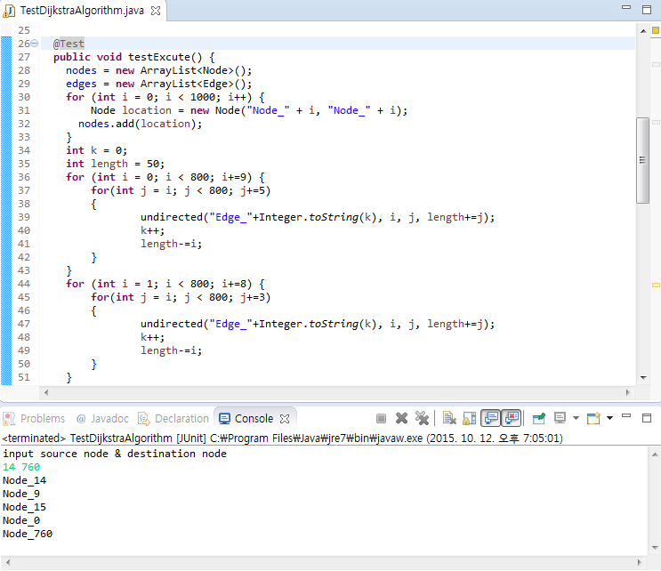
Demonstration
Use for statement to make test case
Path that node 14 to node 760
14 > 9 > 15 > 0 > 760

Slide 9
Q & A

Slide 10
Thank You

